Slide 1


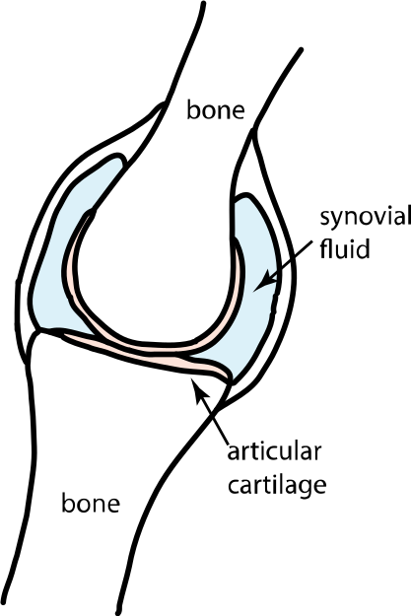
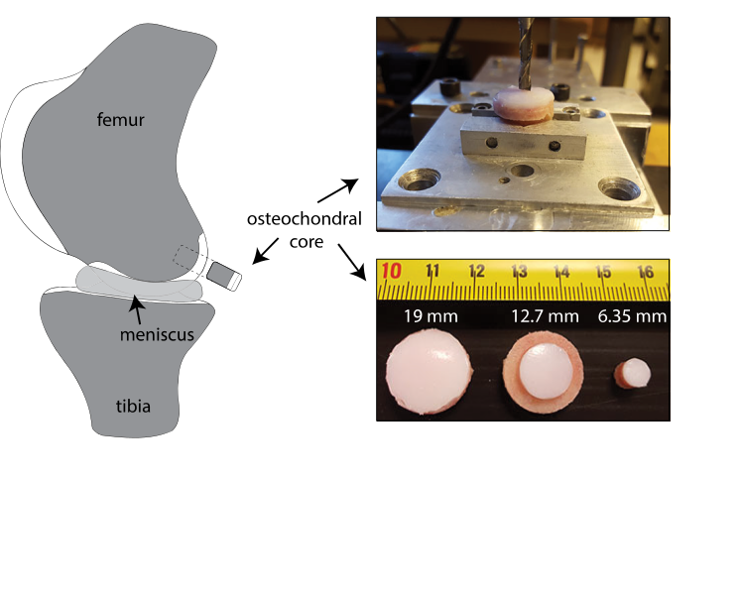
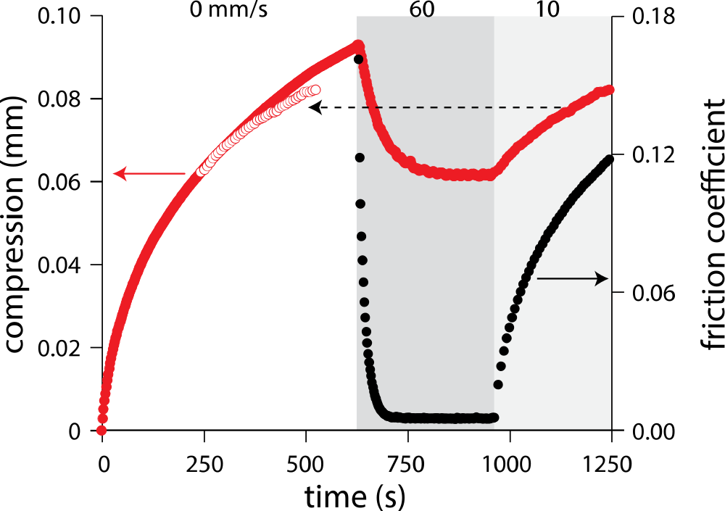
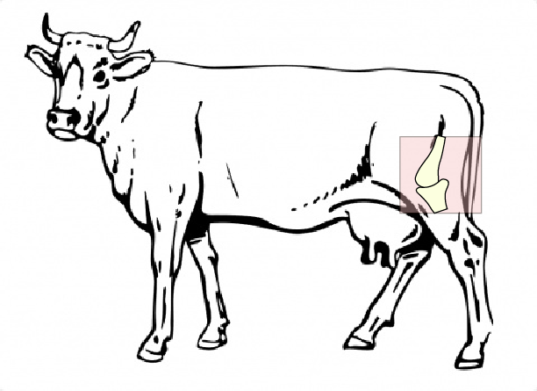
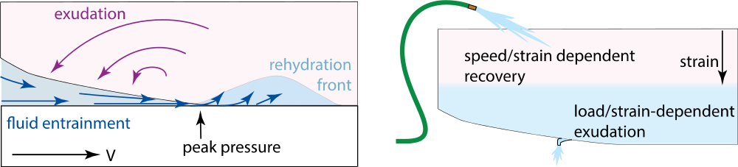
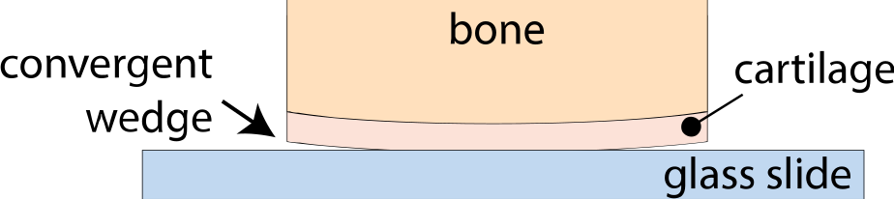
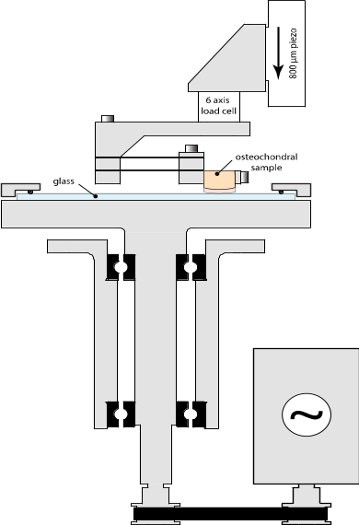
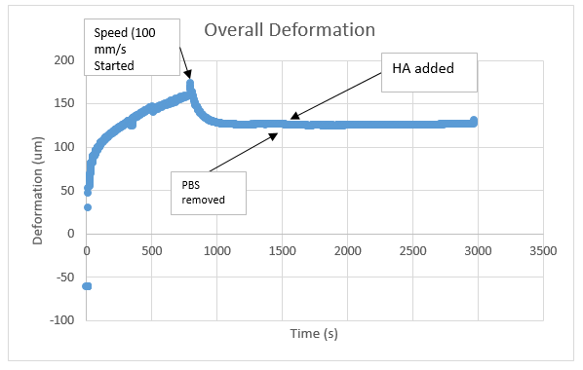
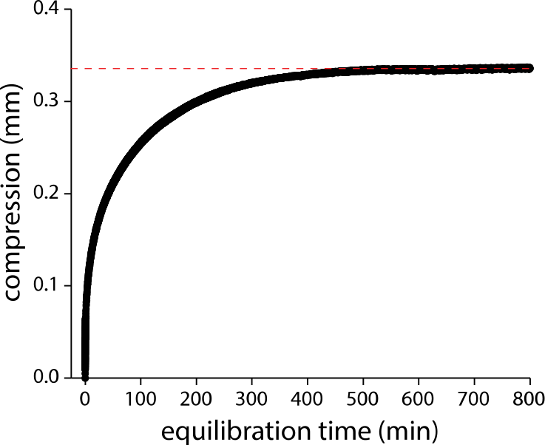
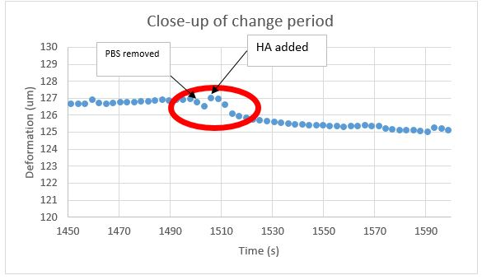
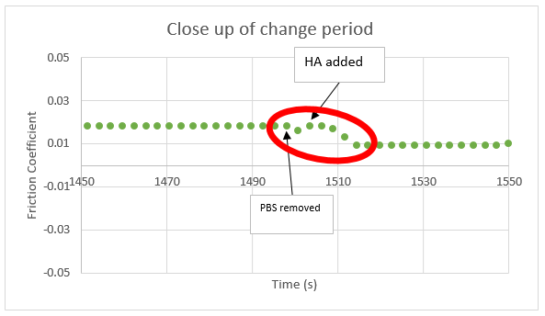
Determine if the Cause of Articular Cartilage’s Low Friction is a Fluid Film
Abstract
Lucas Ramsey
Jordyn Schrader
Axel Moore
Dr. David Burris
Articular cartilage is a thin hydrated tissue that covers the ends of bones that form articulating joints (Figure 1). The Burris group recently discovered a novel hydration recovery mechanism for articular cartilage termed tribological rehydration (Figure 4). While the mechanics underlying this phenomenon have yet to be fully understood, it appears that sliding-induced hydrodynamic pressures may play a major role.
Hydrodynamic theory has only been described for impermeable bearing surfaces and leads to the development of a fluid film. As the Burris group has shown, the permeable cartilage interface provides an alternative path of fluid flow into the cartilage. The question remains as to whether this fluid is also capable of forming a fluid film. This study investigates how a high viscosity, physiologically relevant, fluid injection alters the tribological response. The objective of this study is to determine if a higher viscosity fluid is capable of creating a fluid film.
Figure 2. Where cartilage samples were acquired from on the cow (left) and specifically where in the knee (right).
McCutchen 1962
Figure 1. Location of articular cartilage and synovial fluid in knee
Data 1. Example of previous speed sweep done with speeds of 60 mm/s and 10 mm/s
Figure 3. Location of a convergent wedge when cartilage is in contact with a surface
Figure 4.Tribiological Rehydration mechanism
Motivation
Articular cartilage is a low friction and nearly wear-free material that enables pain free joint activity. Osteoarthritis is the generic name used to describe the loss of cartilage and bone on bone contact. The goal of this study is to determine if visco-supplementation of articular cartilage leads to the development of a fluid film or to enhanced tribological rehydration of the near surface.
Figure 5. (right) POD aka “Pin on Disk” machine diagram
Figure 6. (right) Graph indicating equilibrium
Results & Conclusion
Methods and Procedure
The data demonstrates that following a period of fluid exudation in PBS and then subsequent sliding at 100 mm/s the samples achieved low steady state friction coefficients and deformation. The brief removal of the PBS had little to no influence on the tribological response. The addition of 10 mL 3 mg/ml HA lead to a 50% reduction in friction and a compression recovery of 1 um.
Initially these results would suggest the development of a fluid films, however upon further inspection it can be seen that the dynamics are inconsistent with fluid film theory. Under steady state conditions (speed, load, fluid viscosity, etc.) fluid films should form almost instantly. This would be interpreted as an almost instantaneous drop in the friction coefficient and compression response. Instead the figures in Data 3 demonstrate that it takes 12 seconds for the friction and compression response to stabilize.
The results support the idea that hydrodynamic forces are the underlying mechanism of tribological rehydration (increased viscosity = increased hydrodynamic fluid pressure) and does not require the development of a hydrodynamic fluid film.
Allow cartilage acquired from cow leg (Figure 2) to equilibrate (Figure 6) overnight with 5N load on POD (Figure 5) with PBS (saline solution).
Data 2. Deformation results over entire experiment
After equilibrium is reached, slide at 100 mm/s linear speed until equilibrium is reached again.
While keeping speed constant, replace PBS with HA(hyaluronic acid) and run until equilibrium.
Data 3. Deformation (left) and friction coefficient (right) during change to hyaluronic acid

