Slide 1


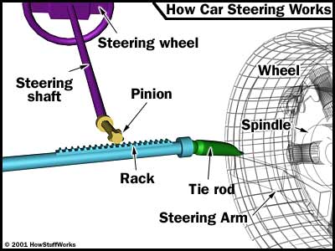
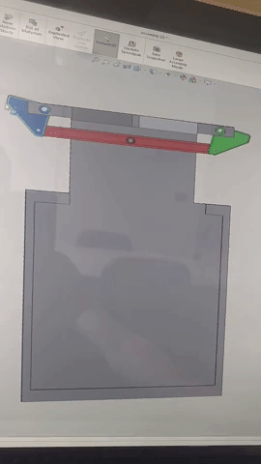
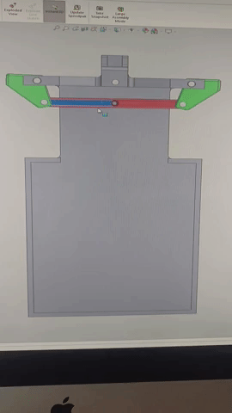
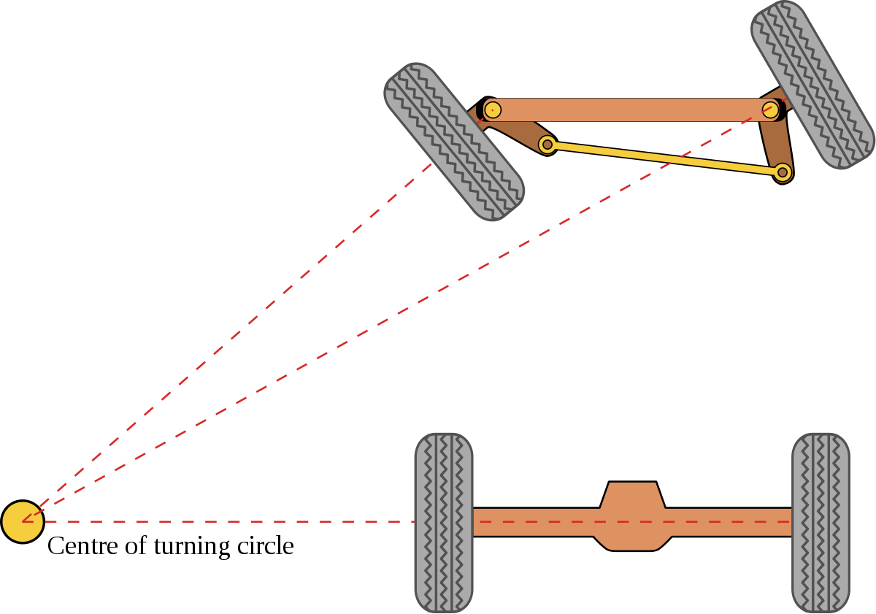
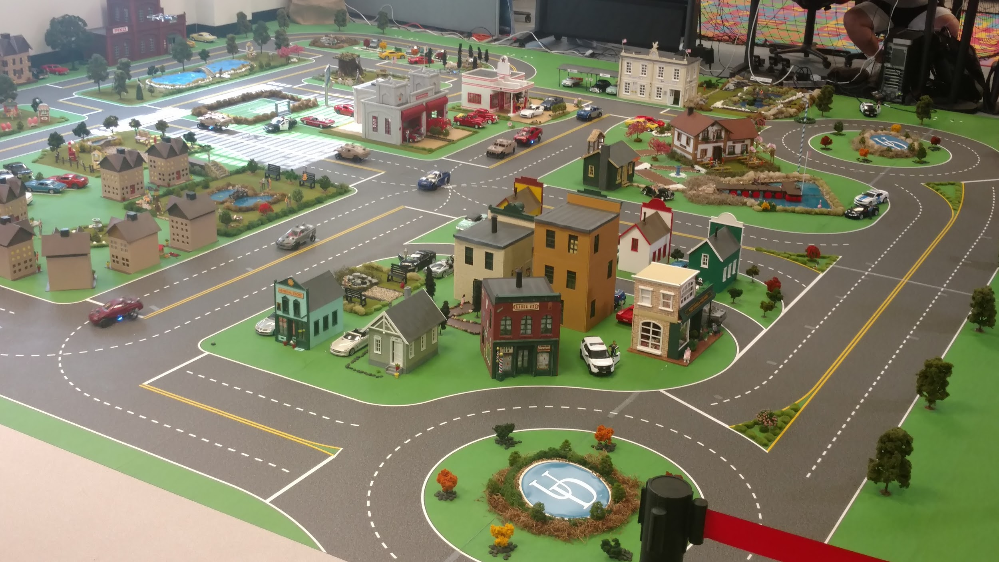
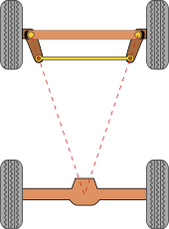
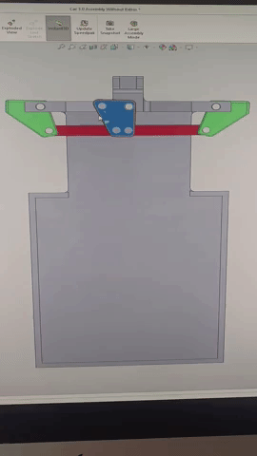
Creating a Realistic Form of Steering for Smart-City Cars
Abstract
Lucas Ramsey
Melody Cerro
Benjamin Remer
Dr. Andreas A. Malikopoulos
As the technology used on a daily basis continues to advance, it is a necessity be able to replicate and test new technologies at a smaller scale before implementing them into the real world. One of the big changes of the future will come with transportation, mainly in making it entirely automated. By creating the University of Delaware Scaled Smart City (UDSSC), one can test what an entire city with automated transportation would look like. Since the entire city is automated, different programs and codes can be tested to see which will make it most optimal. In order to create realistic vehicles to conduct tests on, the steering mechanism needs to be similar to that of real cars, but still allow the cars to travel through the scaled city efficiently.
Figure 3. Rack and Pinion steering in a modern car
Figure 1. Diagram of Ackerman steering system and its purpose
Motivation
Cars in the real world have a unique steering system that turns both wheels simultaneously called rack and pinion(Figure 3). This involves a gear running on a track with ridges, and when the gear spins it pulls the track in one direction. This track is then attached to the wheels, which turn when the track is pulled in one direction or another. By turning the steering wheel inside the car, which moves the gear, the driver can accurately steer the car. An Ackerman steering system (Figure 1) has both wheels on individual rotational points connected by a separate bar. A “Perfect Ackerman” (figure 2) is one that turns both wheels so they are perpendicular to the center of the circle they are turning on. This allows the vehicle to travel around a turn of any radius. Due to the scaled size of the cars (approximately 1:24 scale as cars in the real world), an accurate rack and pinion system is not easily replicated to make the steering accurate. Therefore, an Ackerman system needed to be created in order for the steering of the cars to be realistic.
Model 1. Initial single bar system (left) and system adjusted into “Perfect Ackerman” (right)
Figure 4. The UD Scaled Smart City
Figure 2. How the “Perfect Ackerman” system is designed
Methods and Procedure
Results & Conclusion
Design a CAD model(Model 1) of Ackerman steering system (Figure 1) with single bar on a basic chassis
The double bar perfect Ackerman steering system with attachment point to the servo allows for almost perfect translation from real-world dynamics of vehicle motion into the UD Simulated Smart City. Due to this design including two bars connected by a central piece, but still allowing both bars to rotate freely, steering is able to be motorized in order to simulate that of a real car. While the single bar does work in theory, making it motorized on a smaller scale proved very difficult due to the bar moving in two dimensions. However, the double bar with central rotational piece was able to be motorized and controlled rather easily since the central piece was able to be attached to a servo motor. By changing the cars in the Simulated Smart City to have a steering system more consistent with that of cars in the real world, we are able to conduct tests that would more accurately translate to modern vehicles.
Adjust the model (Model 1) to make it a “Perfect Ackerman Steering System” (Figure 2)
Make changes to the basic chassis as well as create new parts for a double bar perfect Ackerman system (Model 2)
Model 3. Double bar perfect Ackerman system with central rotational piece

